Slide 1
An evaluation framework for personalization strategy experiment designs
C. H. Bryan Liu¹ ² Emma J. McCoy ¹
¹ Imperial College London
² ASOS.com
Aug 2020

Slide 2
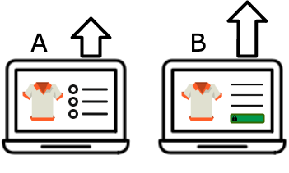
Online Controlled Experiments…
…meet Personalization Strategies

Slide 3
A personalization strategy can be (in marketing)…
Scheduling
Budgeting
Ordering
… of activities directed at a user based on purchase history.
Notes:
Scheduling icon: Schedule icon by Icons8 - https://icons8.com/icon/117507/schedule
Budgeting icon: Icons made by Flat Icons - https://www.flaticon.com/free-icon/budgeting_2535012
Ordering icon: Reorder icon by Icons8 - https://icons8.com/icon/92043/reorder

Slide 4
Two challenges:
Strategies only applicable to small fraction of user base
Users are not randomly assigned a priori, but qualified first via their actions/attributes
Low sample size / power
Groups not statistically equivalent
Notes:
Low sample size / power challenge - People vector created by freepik - https://www.freepik.com/free-photos-vectors/people
Statistically not equivalent challenge – Meme generator by imgflip - https://imgflip.com/i/485ynu

Slide 5
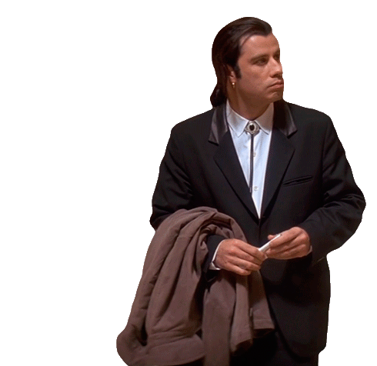
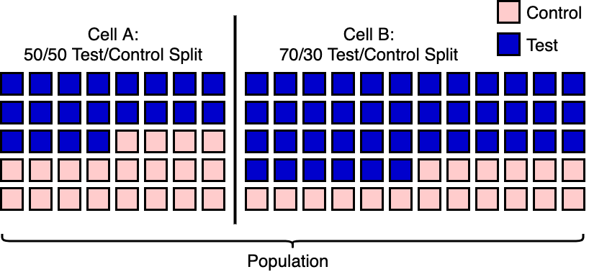
Focus on the setup!
Experiment setup (n.) The assignment of users from strategies they qualified for to the treatment/analysis groups.
Scalable:
No ad hoc strata / control variates
Frameworks can switch setups quickly
Challenge: Lack of ways to systematically compare setups
Many examples exist
(e.g. dual control / multi-cell lift test)
Notes:
Scalability icon – Scale up icon by Zwoelf - https://icon-icons.com/icon/scale-up/120329
Dual control / multi-cell lift test illustration – Liu et al. (2018) Designing Experiments to Measure Incrementality on Facebook

Slide 6
Outline
An evaluation framework for personalization strategy experiments – an overview
Some rule of thumbs from the framework
Is dilution always bad?
When is dual control better?
Mathematical derivations of the rule of thumbs
Experiments
Where are we heading?

Slide 7
THE EVALUATION FRAMEWORK

Slide 8
If we design an experiment for two strategies…
Group 0: Qualify for neither strategy
Group 1
Group 3
Group 2
Qualify for strategy 1
Qualify for strategy 2

Slide 9
If we design an experiment for two strategies…
Group 0: Qualify for neither strategy
Group 1
Group 3
Group 2
Control
Under Intervention
Notes:
Ads icons:
Icons made by Freepik from www.flaticon.com – https://www.flaticon.com/free-icon/online-advertising_1466288
Icons made by Freepik from www.flaticon.com - https://www.flaticon.com/free-icon/mobile-phone_1466324

Slide 10
Four common experiment setups
Setup 1 – Intersection Only
A
∅
∅
∅
∅
B

Slide 11
Four common experiment setups
Setup 1
A
Setup 2 – All samples
A
∅
∅
∅
∅
∅
B
∅
B

Slide 12
Four common experiment setups
Setup 1
A
Setup 2
A
Setup 3 – Qualified users only
A
∅
∅
∅
∅
∅
∅
∅
B
B
∅
B

Slide 13
Four common experiment setups
Setup 1
A
Setup 2
A
Setup 4 – Dual control / multi-cell
∅
∅
∅
A1
∅
∅
∅
∅
∅
A2
B
B
∅
B1
A
∅
Setup 3
B2
∅
A = A2 – A1
B = B2 – B1
∅
B

Slide 14
Four common experiment setups
Setup 1
A
Setup 2
A
∅
∅
∅
∅
∅
∅
B
B
Setup 3
A
Setup 4
A1
∅
∅
∅
A2
∅
∅
∅
B1
B2
B
A = A2 – A1
B = B2 – B1

Slide 15
What makes a setup better?
We are interested in:
Actual effect size as presented by the setups: $Δ$
Minimum detectable effect (MDE): $θ$
We say a setup $S$ is superior to a setup $R$ if:
$S$ yields a larger actual effect and have a lower MDE size: $Δ_{S}>Δ_{R} \& θ_{S}<θ_{R}$
The gain in actual effect > the loss in sensitivity: $Δ_{S}−Δ_{R}>θ_{S} −θ_{R}$

Slide 16
Not covered in the past 10 mins…
An evaluation framework for personalization strategy experiments – an overview
Some rule of thumbs from the framework
Is dilution always bad?
When is dual control better?
Mathematical derivations of the rule of thumbs
Experiments
Where are we heading?

Slide 17
Liu and McCoy (2020)
An evaluation framework for personalization strategy experiment designs
@AdKDD 2020 – in conjunction with KDD’20
Code available at: github.com/liuchbryan/experiment_design_evaluation

